Slide 1
Thesis Statements

Slide 2
Thesis #3
Information Systems have as an objective to support the business in three ways: assisting in day-to-day business operations, producing information for decision-making,
and providing the foundation for the strategy of the company. Management should then have a grand IT vision resulting in a portfolio of IS projects that address this objective.
Any benefit derived from the use of these information systems should be measured in terms of efficiency and effectiveness – and not on the ROI. After all, there are IT investments that deliver value to an organization even without any demonstrable financial return.

Slide 3
Thesis #4
One of the major goals of an Information System Department is to improve the performance of the end users of the organization through the use of the most appropriate Information Technology.
To effectively address this, the IS Department should create a long term (5-year) strategic IS plan. It is reasonable to assert though that the business strategic plan will drive the strategic IS plan instead of the other way around. Having a clear business strategy is therefore critical.

Slide 4
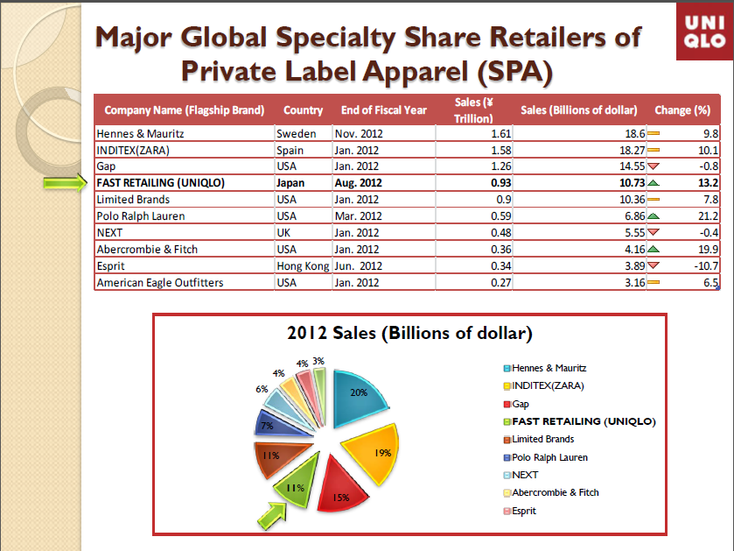

Slide 5
Strategy
Where do we
want to be?
Mission/
Vision
BHAG
UNIQLO:
VISION:
To be the number one clothing retailer in the world
MISSION:
To create truly great clothing with new and unique value, and to enable people all over the world to experience the joy, happiness and satisfaction of wearing such great clothes
To enrich people’s lives through our unique corporate activities, and to seek to grow and develop our company in unity with society
STRATEGY
DIFFERENT
STRATEGIES
We
are
here
ZARA:
VISION:
To give the customer an exclusive
choice of fashion by providing a
quicker turnover of new stock than
other fashion retailers
MISSION:
Zara walks at the pace of society,
dressing ideas, trends and tastes
That society itself has matured
Notes:
How vision will be accomplished over specified time period
Should be aligned with company mission and core values because it provides the architectural bridge between mission and vision
Use of checkpoints and benchmarks to check strategy effectiveness
Vision
Where the company wants to go
What the company aspires to be
Clear, compelling, exciting
Must be BHAG!
Mission
Reasons the company exists
Concise statement of what business the group is in
Purpose and function of the company
Needs to be reviewed to identify for themes and ideas
Identify core values

Slide 6
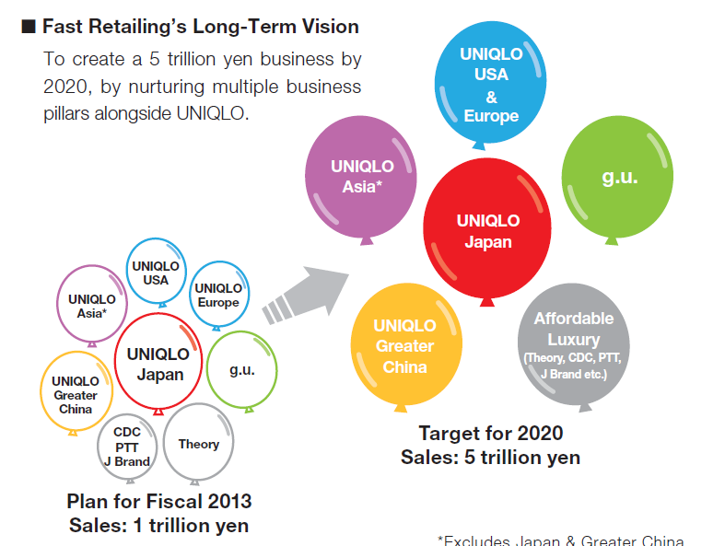
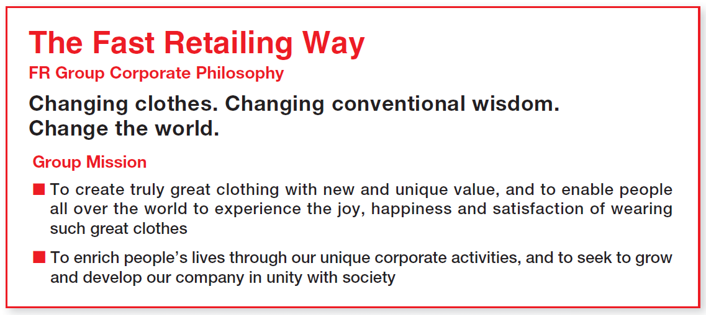
Cascading the VM
UNIQLO:
VISION:
To be the number one clothing retailer in the world
MISSION:
To create truly great clothing with new and unique value, and to enable people all over the world to experience the joy, happiness and satisfaction of wearing such great clothes
To enrich people’s lives through our unique corporate activities, and to seek to grow and develop our company in unity with society

Slide 7
Cascading Measures and Goals
5 % increase in profit
profit share of growing markets >= 35%
# 1 or 2 position in all brands
CEO
For mature markets:
4% increase in profit
# 1 or 2 position in all brands
$ savings
For growing markets:
12% increase in profit
PRESIDENT
FOR ASIA PAC
PRESIDENT
FOR EMEA
2% increase in profit
90% of tier 1 stores carry product
30% new business success rate
4% increase in profit
15% increase in revenue
capture 60% of teen market
$ savings
GENERAL MGR FOR
PHILIPPINES
MKTG DIRECTOR
capture 60% of teen market
$ savings from advertising
70% successful initiatives
SALES DIRECTOR
15% increase in revenue
12% increase channel partners
90% partners compliant w/ policy
HR DIRECTOR
ACCOUNT OWNER
5% increase in revenue
all stores compliant w/ policy
12 joint promotions for the year
$ savings from benefits ration.
recruiting time of 30 days

Slide 8
Strategic Management Process
1
Review/revise mission
External environment-- opportunities and threats
Internal environment-- strengths and weaknesses
New goals and objectives
2
Strategic Management Process Includes Four Activities
1. Review and define the organizational mission. 2. Set long-range goals and objectives. 3. Analyze and formulate strategies to reach objectives. 4. Implement strategies through projects.
Portfolio of strategic choices
3
Strategy formulation
Strategy implementation
4
Projects

Slide 9
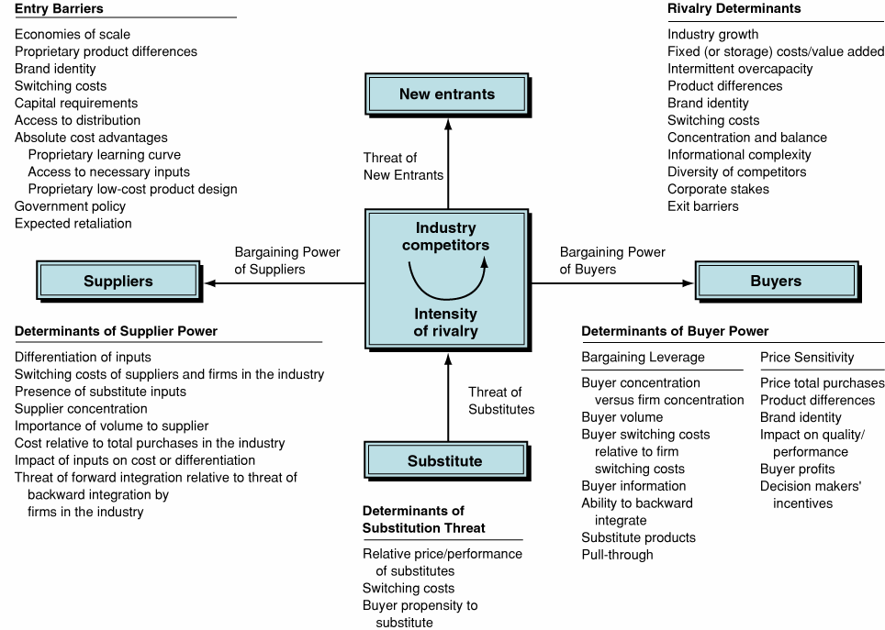
Look outside: Porter’s Five Forces
5 FORCES MODEL
Note: The firm must also consider macroeconomic (political, economic, demographic, etc.) changes.

Slide 10
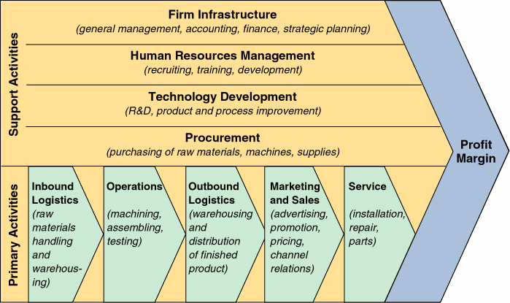
Look inside: Value Chain

Slide 11
Strategic Information System
Intimate understanding of customers and evolving needs
Managing knowledge- and information- based asset management
Continuously innovate strategically relevant new processes
Coordination of activities involving people, procedures, and technology

Slide 12
Apple, 2008

Slide 13
Apple’s Competitive Advantages were..
Ease of use
Dominance in creative industries
Buyer loyalty
Proprietary operating systems
Great and strong branding
Industrial designs

Slide 14
Presently, competitive advantage today may require one or more of the following…
Unsurpassed relationships with one’s customers and suppliers
Unique and adaptable business processes
Ability to harness information and knowledge of employees
Must become “Change Leaders”

Slide 15
What Business Strategy Choices Should be made?
Selection of business goals
Choice of products and services to offer
Design and configuration of policies
Appropriate level of scope and diversity
Design and organization structure and administrative systems

Slide 16
OK, so now we look at the structure of the PC industry

Slide 17
If Apple always had a unique product, why has Apple had so much difficulty in the PC industry over time?

Slide 18
Apple
Vision
“An Apple at every desk!”
"To make a contribution to the world by making tools for the mind that advance humankind."
Mission
“Apple is committed to bringing the best personal computing experience to students, educators, creative professionals and consumers around the world through its innovative hardware, software and Internet offerings.”

Slide 19

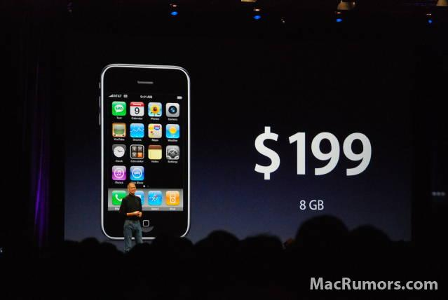
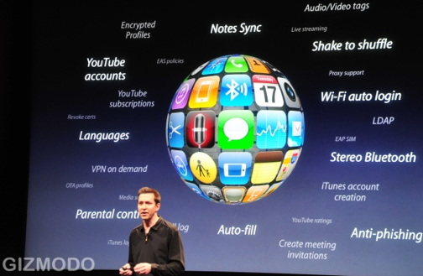
So, let’s go forward and compare the strategy of…
iPhone 1.0
iPhone 2.0
iPhone 3.0

Slide 20
Information Systems Planning

Slide 21
IS and IT Strategies are….
A set of decisions made by IT and senior management…
…it involves the deployment of technology infrastructures,
and reinforces the relationship of technology choices to business choices

Slide 22
Why is IS planning difficult?
Materials (hard/software) continuously change
$
Joint responsibility/approach: top-down vs. bottom-up
Aligning business goals and systems plans

Slide 23
IT Roles in Strategy
Transformation driver
Create and exploit new markets
Link customers to firm
Define new standards of excellence
Enabler of transformation
Interconnect people and processes
Span organization boundaries
Bridge geographical distances
IT can also Inhibit Strategy
IT strategy not aligned with business strategy
Over-emphasis on technology
Failure to recognize effective use of IT requires business process change

Slide 24
Strategic Alignment Model: At the Business Level
Scope of Firm’s Business
Customers, products, markets, and competitors
Distinctive Competencies
Core competencies
Critical success factors that provide competitive advantage
Governance of the Firm
Impact of regulatory agencies

Slide 25
Strategic Alignment Model : At the IS Level
Scope of Firm’s Technology
Impact and support business strategy decisions and initiatives
Systemic Competencies
Technology capabilities
IT Governance
Pursue relationships and alliances to obtain IT competencies

Slide 26
Strategic Alignment Model : At the IT Level
IT Architecture
Selection of technology and infrastructure
Models used to define data, information, networks, applications, and systems
IT Organizational Processes
Critical to operation of IT organization
Systems development, IT operations
IT Skills
Acquisition and development of people

Slide 27
Question: How does all this discussion relate to the ZARA case?

Slide 28
Strategic Information Technology Planning – Four Methodologies
Critical success factors
Stages of Growth
Scenario Planning
Porter’s and Miller’s Five Step Process

Slide 29
Strategic Information Technology Planning – Methodologies (Continued)
Critical success factors (CSFs) are those few things that must go right in order to ensure the organization's survival and success. Critical success factors vary by industry categories—manufacturing, service, or government—and by specific industries within these categories.
Sample questions asked in the CSF approach are:
What objectives are central to your organization?
What are the critical factors that are essential to meeting these objectives?
What decisions or actions are key to these critical factors?
What variables underlie these decisions, and how are they measured?
What information systems can supply these measures?

Slide 30
Satisfying Customer Demands Depends on Five Critical Success Factors
WAL-MART: BUSINESS PROCESS
Critical Success Factors (CSF)
Quick responsiveness to market changes
Low inventory
Quick replenishment of inventory
Effective human resource system
Efficient distribution system
Customer Demands
The right products
In stock
Best value
Service and quality

Slide 31
Wal-Mart Fulfills the Customer-Satisfaction Critical Success Factors
WAL-MART: BUSINESS PROCESS
Customer demand “pulls” product through the supply chain
Tracking product movement at individual stores by market traits (e.g., size, color)
Investment in IT ensures timely analysis of sales/customer/market information and trends
Formal and informal cooperation among stores, distribution centers, and suppliers
CSF
Quick Responsiveness
to Market Changes
Low Inventory
Quick Replenishment
Effective HR System
Efficient Distribution
System

Slide 32
Wal-Mart Fulfills the Customer-Satisfaction Critical Success Factors (cont.)
WAL-MART: BUSINESS PROCESS
Direct high-level and long-term relationship with suppliers enabled by high information sharing:
Some vendors directly manage distribution warehouse inventory of their products
Efficient transportation system
Investment in IT (e.g., EDI, Quick Response, Radio frequency terminals)
CSF
Quick Responsiveness
to Market Changes
Low Inventory
Quick Replenishment
Effective HR System
Efficient Distribution
System

Slide 33
Wal-Mart Fulfills the Customer-Satisfaction Critical Success Factors (cont.)
WAL-MART: BUSINESS PROCESS
All employees are considered “associates”
Extensive training and support
Stock-ownership program
Profit-sharing
CSF
Quick Responsiveness
to Market Changes
Low Inventory
Quick Replenishment
Effective HR System
Efficient Distribution
System
“Employees are your biggest capital investment, so it makes sense to maintain them—their skills, their morale, and their participation.”

Slide 34
Wal-Mart Fulfills the Customer-Satisfaction Critical Success Factors (cont.)
WAL-MART: BUSINESS PROCESS
Highly automated distribution centers (e.g., laser-guided conveyor belts)
A fleet of 2,000 company-owned trucks
High leverage of supplier relationships:
Some suppliers ship goods “sales floor ready”
CSF
Quick Responsiveness
to Market Changes
Low Inventory
Quick Replenishment
Effective HR System
Efficient Distribution
System
Video 1

Slide 35
IT is Critical for Wal-Mart’s “Everyday Low Price” Strategy
Video 2
Invested in most of the waves of retail IT systems earlier and more aggressively than its competitors
- Set industry standards in IT
1969 : Used computers to track store inventory
1980 : Adopted bar codes
1985 : Electronic Data Interchange (EDI) with suppliers
Late 80’s : Wireless scanning guns
2003 : Mandated its 100 largest suppliers to place RFID (Radio Frequency Identification) tags on the boxes and pallets shipped to Wal-mart stores by January 2005
Focus of IT Investments:
Applications that directly enhanced its core value proposition – EDLP – and increasing sales through micromerchandising

Slide 36
Wal-Mart Invests Heavily in Information Technology
Inventory Tracking and Management System at distribution centers:
Identifies every product and its location in the warehouse
Integrated with some 8.5 miles of laser-guided conveyor belts
Lasers read the bar code on every product box and route them to appropriate loading dock

Slide 37
Wal-Mart Invests Heavily in Information Technology
Electronic Data Interchange (EDI):
For electronic transmission of POS data, purchase orders, invoices, advance shipment notice, etc. between Wal-Mart headquarters, suppliers, distribution centers, and individual stores
Merchandising Artificial Intelligence System:
To adjust vendor merchandise assortments based on the need of each particular store
State-of-the-art satellite communication network which supports data, voice, and video

Slide 38
Strategic Information Technology Planning – Methodologies
Stages Of IT Growth Model, indicates that organizations go through six stages of IT growth
Initiation. When computers are initially introduced.
Expansion (Contagion). Centralized growth takes place as users demand more applications.
Control. In response to management concern about cost versus benefits, systems projects are expected to show a return.
Integration. Expenditures on integrating (via telecommunications and databases) existing systems
Data administration. Information requirements rather than processing drive the applications portfolio.
Maturity. The planning and development of IT are closely coordinated with business development

Slide 39
Strategic Information Technology Planning – Methodologies (Continued)
Scenario planning is a methodology in which planners first create several scenarios, then a team compile possible future events that may influence the outcome of each scenario.

Slide 40
Strategic Information Technology Planning – Methodologies (Continued)
Competition has been affected by IT in three vital ways. First, industry structure and the rules of competition have changed as a result of new information technologies. Second, organizations have outperformed their competitors by using IT. Finally, organizations have created new businesses by using IT. Based on this conclusion, Porter and Millar developed a five-step framework that organizations can use to exploit the strategic opportunities IT creates.
Step 1. Assess information intensity.
Step 2. Determine the role of IT in the industry structure.
Step 3. Identify and rank the ways in which IT can create competitive advantage.
Step 4. Investigate how IT might spawn new businesses. Organizations should answer the following three questions:
What information generated (or potentially generated) by the business should be sold?
What IT capacities exist to start a new business?
Does IT make it feasible to produce new items related to the organization’s current products?
Step 5. Develop a plan for taking advantage of IT.

